Slide 1
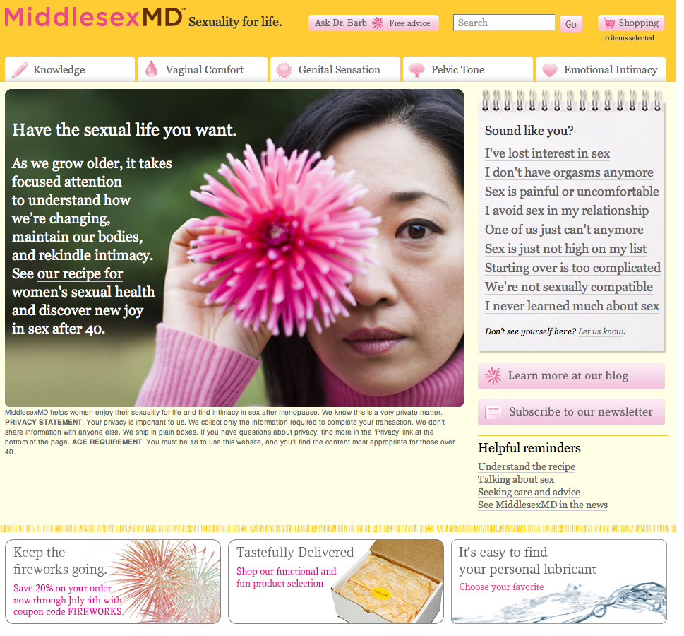
Info and advice on
midlife sexual health
Clinically proven products
Safe online shopping
Discreet packaging
888-398-6763
MiddlesexMD.com
Sexuality for Life

